Slide 1





Students Academic Performance: Does Parents’ Education Matter?
DATA VISUALIZATION
Hussein Shamas

Slide 2
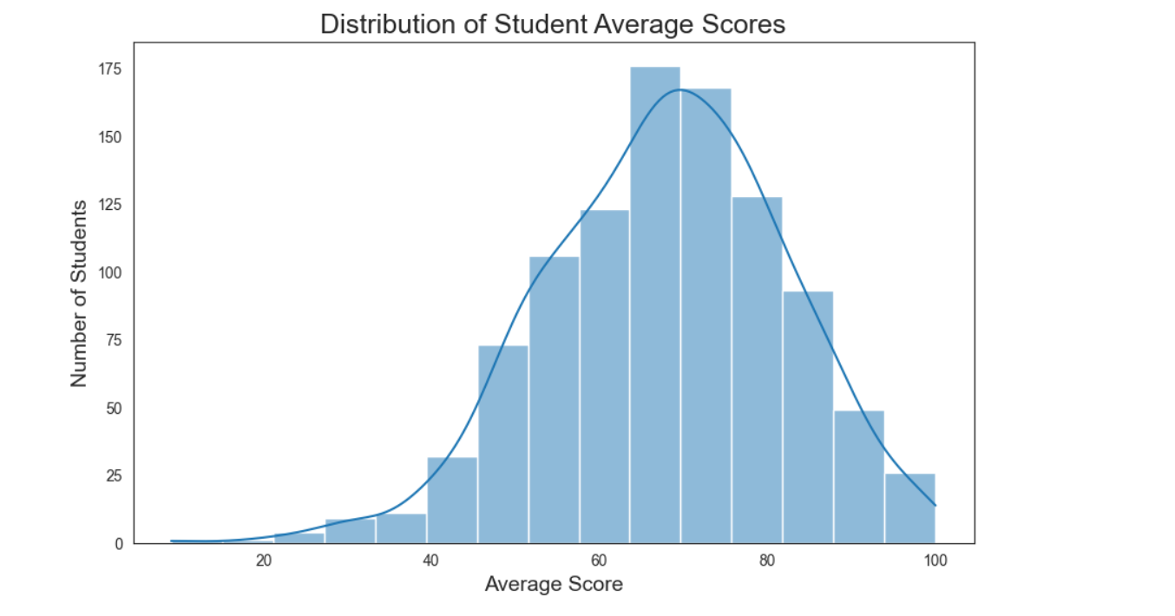
Data Visualization
Individual Assignment
Students Academic Performance: Does Parents’ Education Matter?
Student name: Hussein Shamas
Student ID: 946916
Student e-mail address: H.shamas@unimib.campus.gmail.com

Slide 3
About Data
    Initial considerations:
    The dataset provides detailed academic performance (math, reading, writing) along with demographic and family information for students.
    I wanted a dataset that could help answer whether parents’ education level affects student performance.
    Issues faced while searching for data:
    Many publicly available datasets either lacked parental education info or had incomplete score data.
    Some datasets were focused on specific regions or grades, not providing a generalizable sample.
    Chosen dataset(s):
    “Students Performance in Exams” (Kaggle) — contains 1000+ students, includes math, reading, writing scores, gender, test prep course, and parental education level. Link: StudentsPerformance
    License:
    Shared under Kaggle’s terms of use, allowing non-commercial research and academic work.
    This means I can analyze, visualize, and present findings for educational purposes but cannot redistribute the raw dataset publicly.
Data quality & completeness concerns:
Dataset is mostly clean, but potential issues include:
  Some parental education categories have fewer students (imbalanced groups).
  Cross-sectional survey — cannot analyze trends over time.
  Scores are standardized but may have minor input errors (unlikely, given Kaggle verification).

Slide 4
About Data
Anticipated data cleaning operations:
Renaming columns for clarity.
Creating derived variables like average score or total score.
Converting categorical columns (e.g parental level of education) to consistent naming.
Checking for missing values (none in this dataset, but verified programmatically).

Slide 5
Methodology
Data Collection:
Dataset obtained from Kaggle (“Students Performance in Exams”), downloaded manually.
No scraping or APIs were used, as the dataset is fully provided in CSV format.
Data Processing & Cleaning:
Processed using Python in Jupyter Notebook.
Key libraries: pandas (data handling), numpy (numeric operations), matplotlib & seaborn (visualization).
Checked for missing values, corrected inconsistent column names, and verified data types.
Data Transformation:
Created derived variables:
  Average score = mean of math, reading, and writing scores per student
  Total_score = sum of math, reading, and writing scores
Aggregated data by parental education level for analysis.
Encoded categorical variables consistently for plotting and statistical analysis.
Use of AI Tools:
ChatGPT used for:
  Suggestions for data cleaning and analysis steps.
All analysis decisions and interpretation were done independently.

Slide 6
Methodology
Analytical Techniques:
Descriptive statistics: mean, median, standard deviation of scores per parental education group.
Comparative analysis: boxplots to compare distributions across groups.
Subject-level comparison: math, reading, writing scores analyzed separately to identify patterns.
Gender & test preparation interactions: additional stratified analysis with visualizations.
Reproducibility:
All code shared in Jupyter Notebook.
Cleaned dataset exported as students_performance_clean.csv.
All steps documented and can be replicated using the provided code and Kaggle dataset.
All was documented on my Github: RepoLink

Slide 7
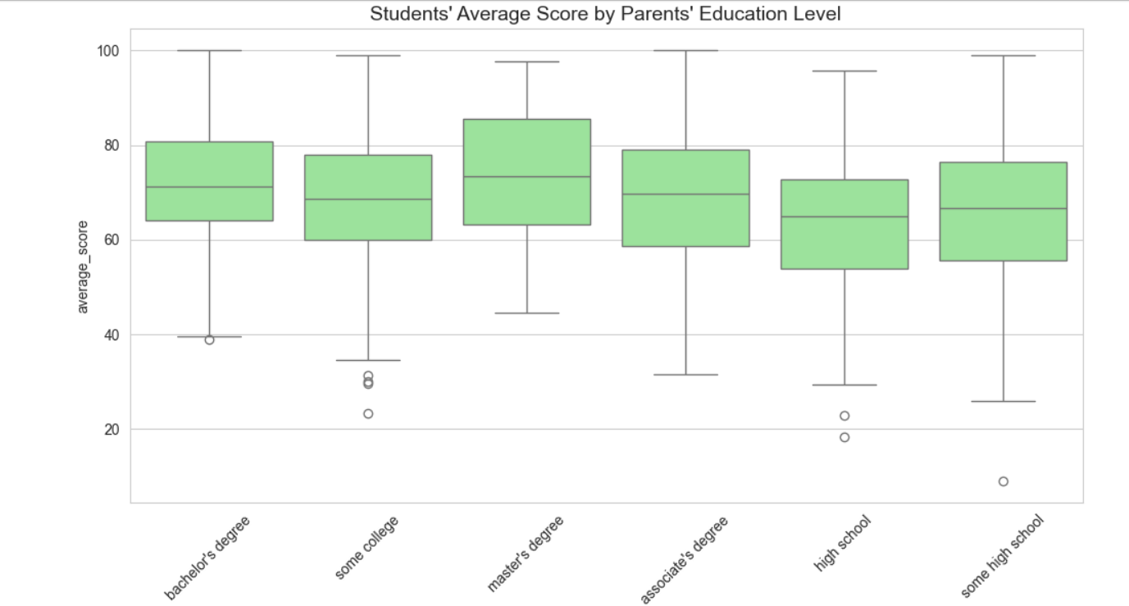
Insights from the Data
Main Insights:
Parental education matters: Students whose parents have higher education (bachelor’s or master’s degree) consistently show higher average scores across math, reading, and writing.
Score ranges:
  Minimum average score: ~50
  Maximum average score: ~100
  Average overall score: ~70–75
Outliers: A few students with very low scores (below 40) and very high scores (above 95) exist, but distribution is generally normal.
Subject differences: Reading and writing scores show a stronger correlation with parental education than math.
Gender trends: Girls slightly outperform boys in reading and writing, while math scores are similar across genders.
Test preparation effect: Completing a test preparation course boosts scores across all parental education groups.

Slide 8
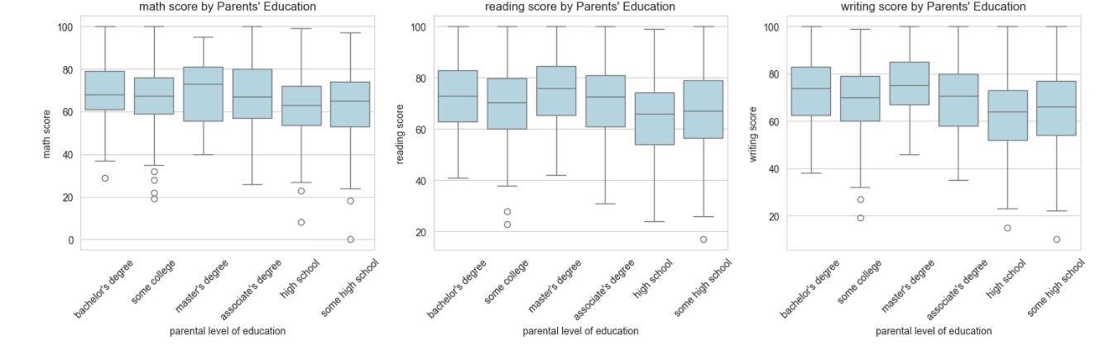
Insights from the Data
Analysis Operations Performed:
Descriptive statistics: mean, median, min, max, standard deviation per parental education group.
Comparative analysis: boxplots comparing average scores across parental education categories.
Subject-level comparison: separate boxplots for math, reading, and writing scores.
Stratified analysis: additional boxplots by gender and test preparation course.

Slide 9
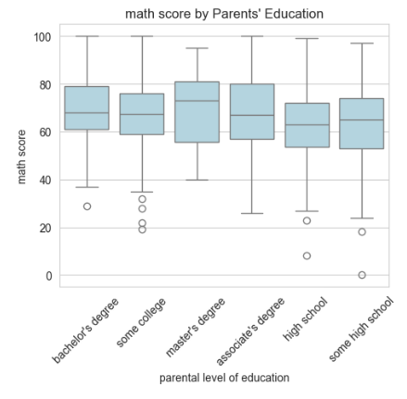
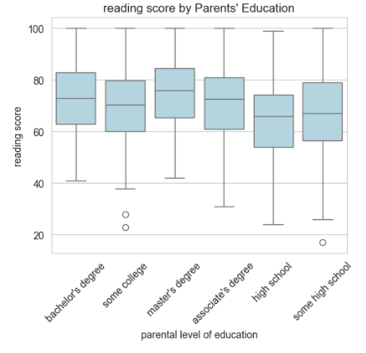
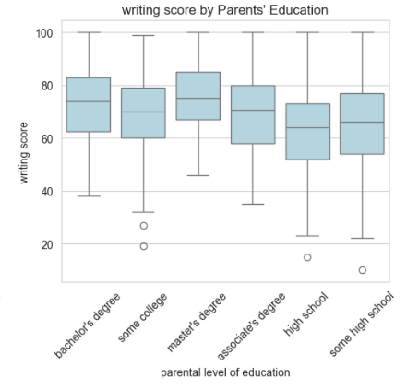
Math Score
Reading Score
Writing Score

Slide 10
License
This work is licensed under a
Creative Commons Attribution 4.0 International License (CC BY 4.0).
You are free to:
Share — copy and redistribute the material in any medium or format
Adapt — remix, transform, and build upon the material for any purpose, even commercially
Under the following terms:
Attribution — You must give appropriate credit.
Link to license:
https://creativecommons.org/licenses/by/4.0/
LICENSE

